Slide 1

Adidas Sales Report for Year 2020 2021
By – Fardeen Ahmed Khan
Power BI Report

Slide 2

Contents of the Report
Data Prior and Post Transformation.
Yearly Sales Analysis of Revenue and Profit.
Analyzing Different Verticals of Adidas and its Impact on Revenue.
Ranking of Different Product Line on Quarterly Basis
Comparison of Revenue from Male and Female Product Line.
Region Analysis For Better Understanding of Revenue Channel.
Different Sales Method and its Impact on Sale of Products.
Retailers Analysis in Contrast of Revenue Pulled by them

Slide 3
Types of Chart Utilized
Line Chart
Bar Chart
Column Chart
Pie Chart
Cards
Ribbon Chart
Waterfall Chart
Region Map

Slide 4
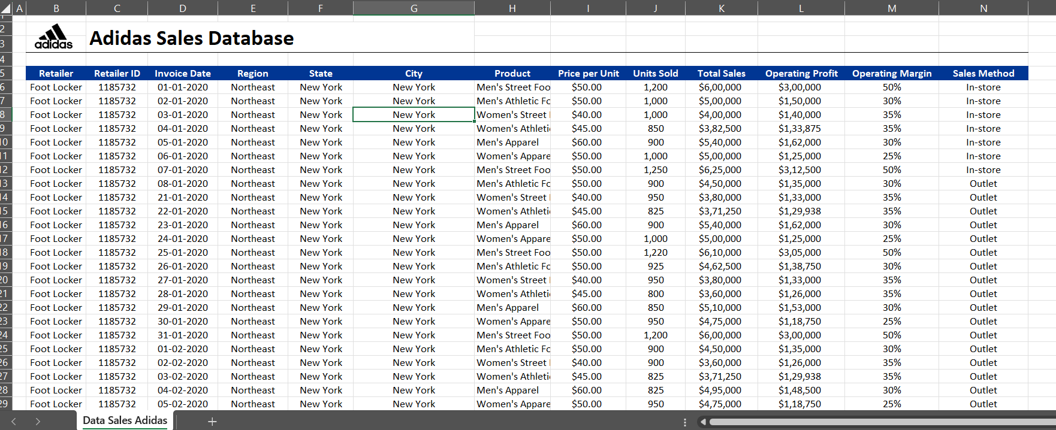
If You Look closely the Huge Mistake here is the Calculation of Total Sales it is Inflated by 1 extra 0 in every cell and same with Operating Profit and We have to combine Region, State, City in a new column to reduce data redundancy and make a normalized data table of Region with Hierarchy in it and we need some calculated column as well.
We will also create a date table for Time Intelligence Function and disable auto date feature of Power Bi.

Slide 5
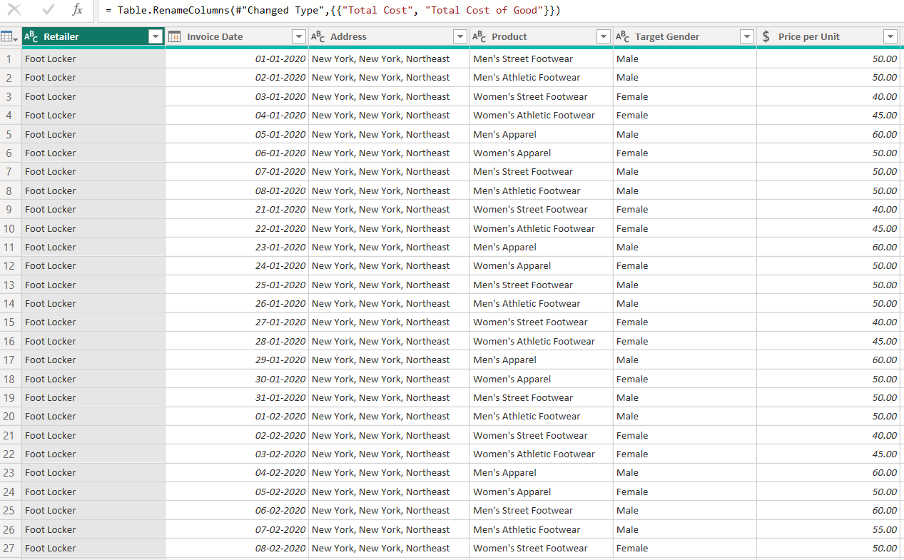
Transformed Data with Calculated Columns and Corrected Formats of Data

Slide 6
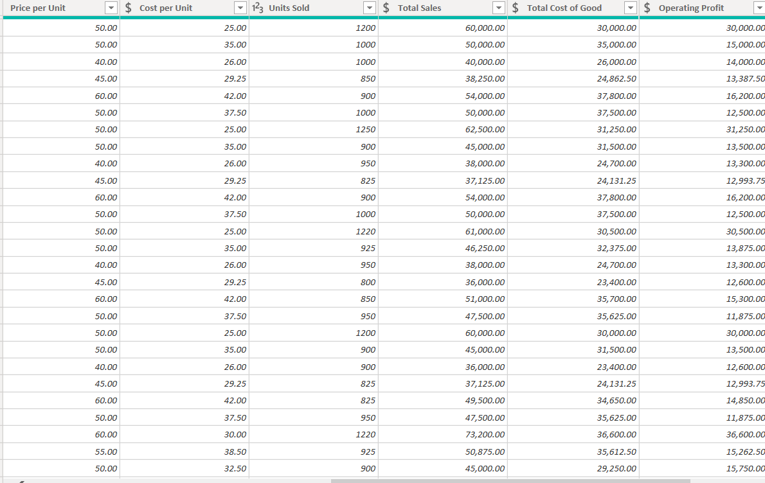

Slide 7
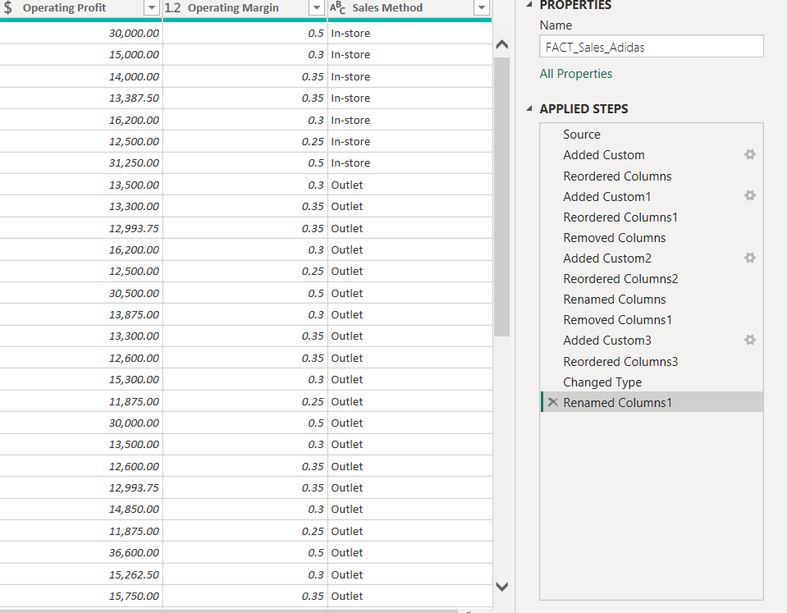

Slide 8
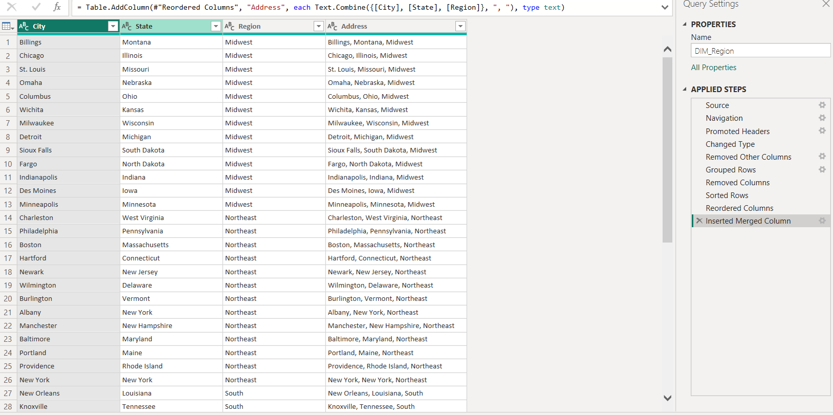
Normalized Region Table with we will create a Relation from fact Table with Address

Slide 9
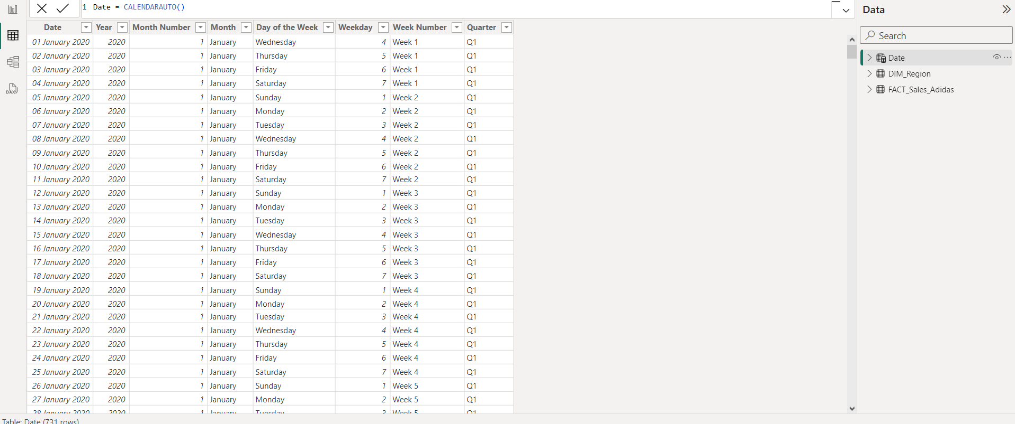
I created a Calculated Date table as well with CALENDARAUTO() Function and All Related Calculated Column so that I can mark this as a Date Table and work with Time Intelligence Functions

Slide 10
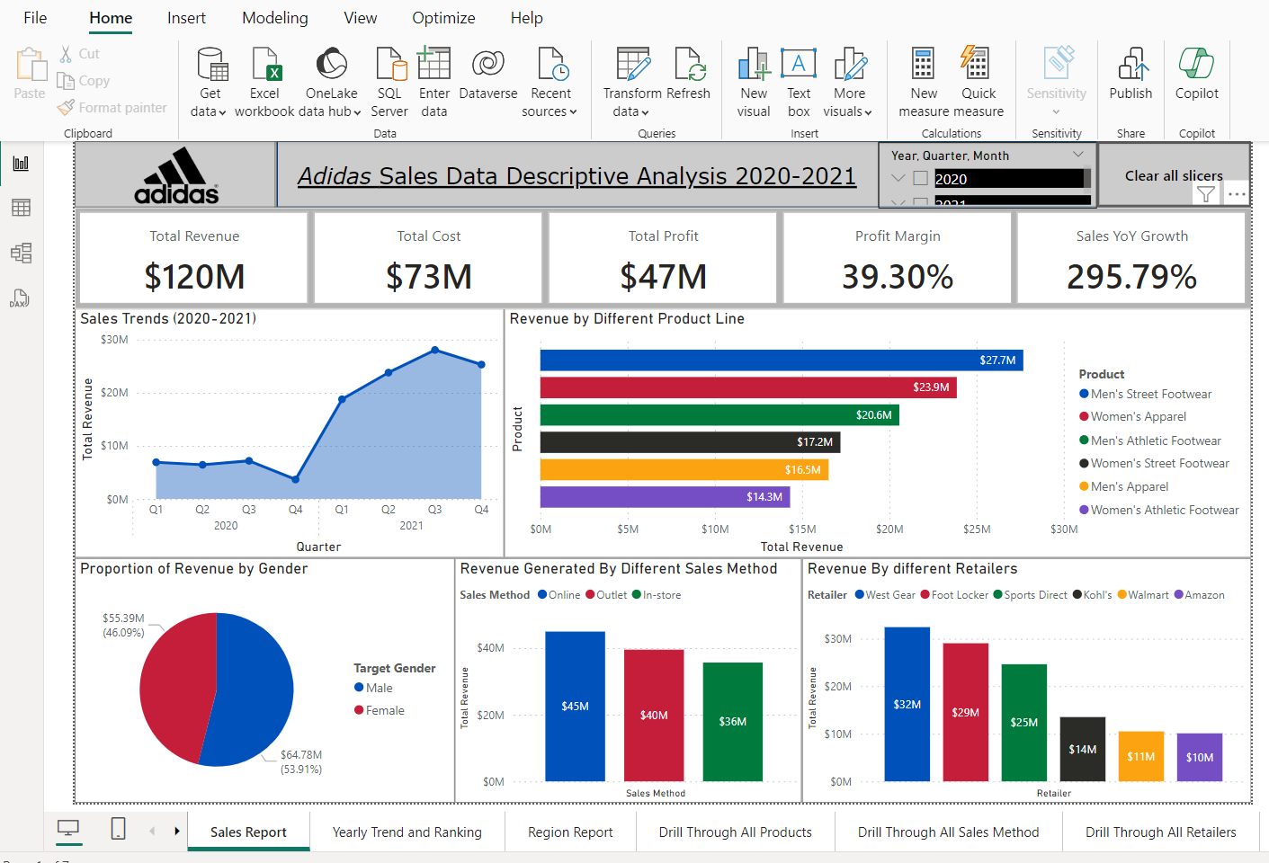
Sales Report Page

Slide 11
KPI Cards For Quick Info and Summary Details Holding Slicers and Button for Clearing Filter of Slicers

Slide 12
Line Chart Depicting Sales from Q1 2020 to Q2 2021 Showing an Impactful Sales Improvement in 2021 as Compared to 2020 Revenue

Slide 13
Revenue Comparison From Different Product Line We Can Observe that Men’s Street Footwear Top the List followed BY Women’s Apparel While Women’s Athletic Footwear is at the Bottom

Slide 14
Revenue Proportion in Contrast of Male and Female Product Line While Men are Leading in Revenue Contribution But the Difference is not Huge

Slide 15
Different Sales Method And Impact on Revenue We Can See that the Best Method of Sale Proven for the Company is Online followed by Outlet and then In-Store

Slide 16
Comparison of Retailers in term of Revenue We Can See that West Gear is the Best Performer in all Retailers While Amazon is the Least Revenue generator.

Slide 17
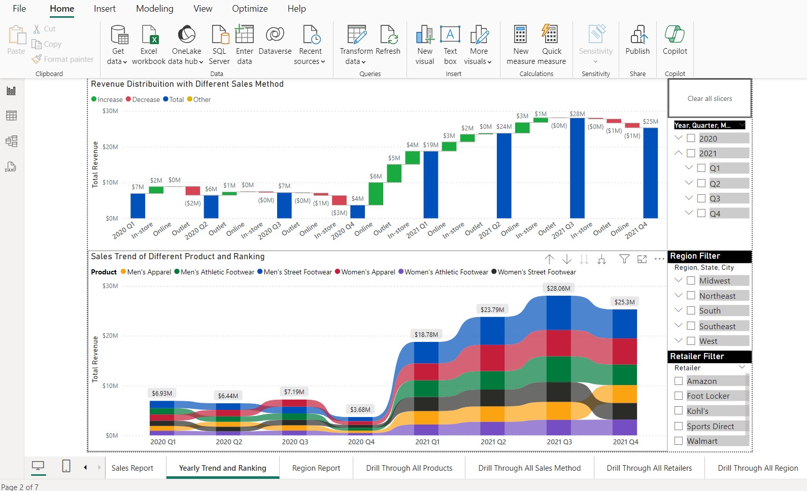
Yearly Ranking and Bifurcation of Revenue

Slide 18
Bifurcation of Revenue Yearly and Quarterly We can see how Revenue is Fluctuating Quarterly with Breakdown of Sales Method and Colour Indicating Whether they are more from the Previous Quarter or Less

Slide 19
Yearly & Quarter Ranking of Product Line We Can See the Men’s Street Footwear Keep the Top position Holding for almost every year while Women’s Athletic Footwear showing Consistency as well at the Bottom of the Ranking in every Year and Quarter.

Slide 20
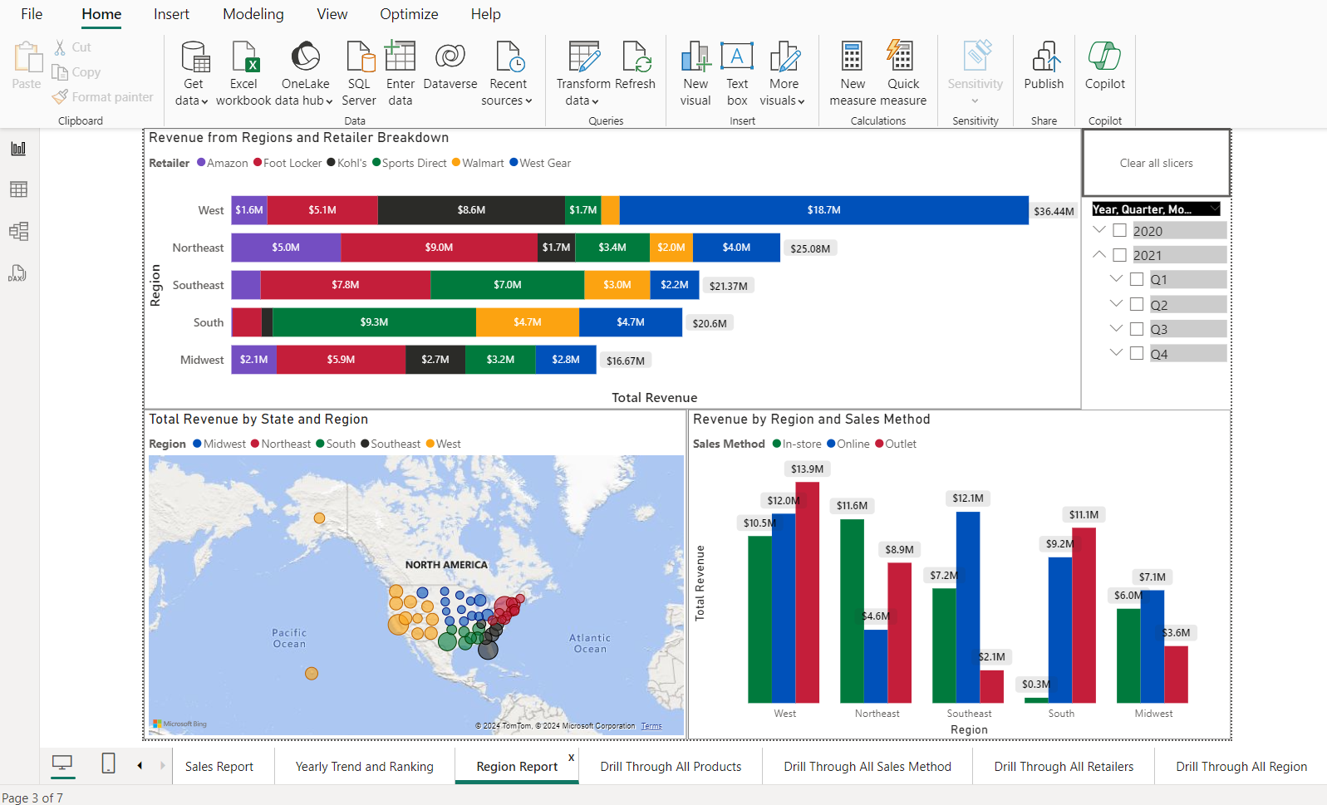
Revenue from Different Regions and States US

Slide 21
Revenue from Different Regions and Different Retailers Contribution from that Region We can See West is the Highest Revenue Source as of Region and West Gear is the Best performer in That Region

Slide 22
Revenue from Different Regions and States US Larger the size means more Revenue and Different color represent different Region of US

Slide 23
Revenue from Different Regions And Which Sales Method is Suiting Best for Revenue in that Region

Slide 24
Conclusion
Sales Trends is Rising and Showing Growth of 295% from Previous Year Comparison
Men’s Street Footwear And Women’s Apparel are Best Product Line
Online Sales Method will keep Rising
West Gear and Foot Locker were the best Retailers
West and Northeast are the Top Region in Revenue Generation and In-Store is what is More Prefeed Here.

